Slide 1


Department of MCA GOVT. P.G. COLLEGE, DHARAMSHALA SESSION: 2023-2025
School of Computer Science & Engineering
Project Proposal Drop shipping Website
MCA-7309P
Submitted by: - Rameshwar, Kritika and Abhishek MCA 3rd Semester Uni. Roll no: 2301372804, 23013728040, 23013728068.
Submitted to: - Dr Satish Sood Asst. Professor. Dept. of MCA
HIMACHAL PRADESH TECHNICAL UNIVERSITY, HAMIRPUR MCA 3rd Semester

Slide 2




Slide 3


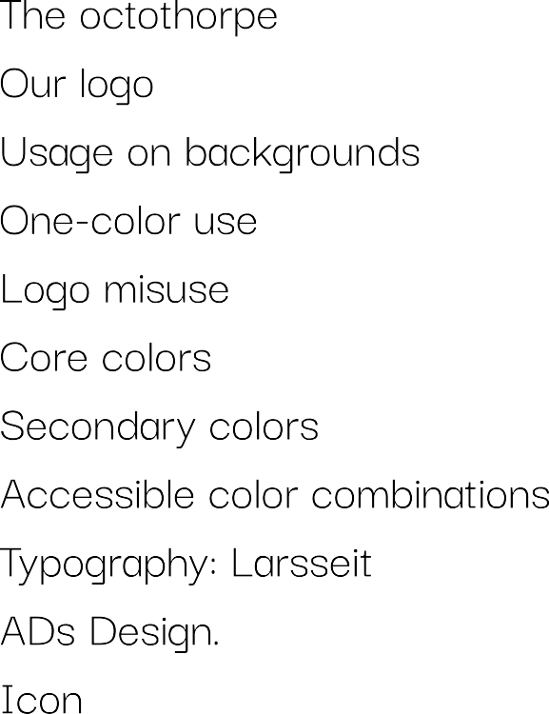

Slide 4


Slide 5



Slide 6
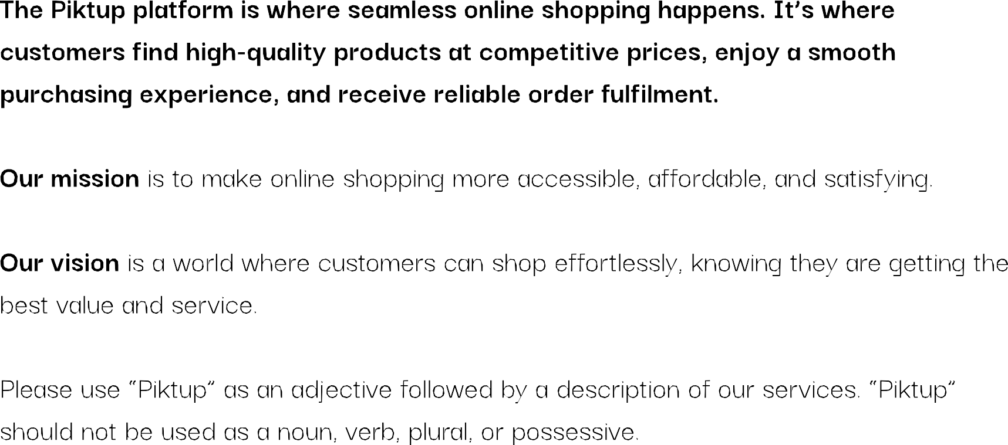

Slide 7


Slide 8
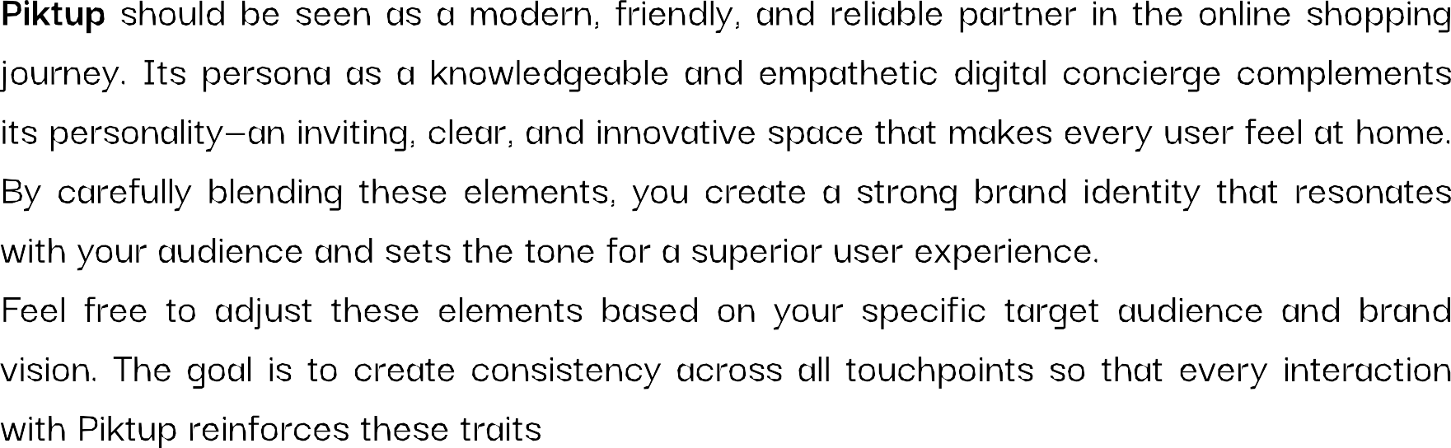

Slide 9

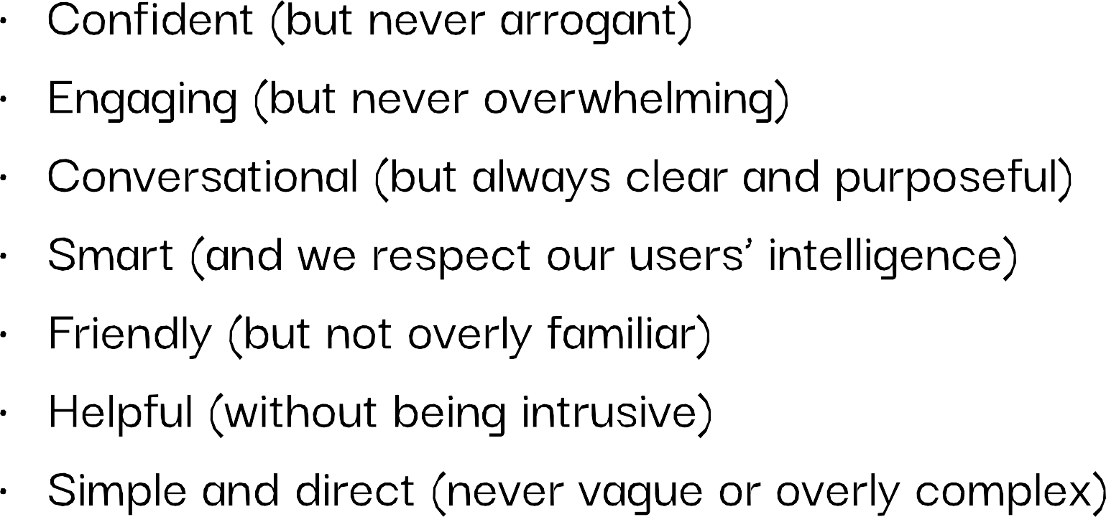

Slide 10



Slide 11
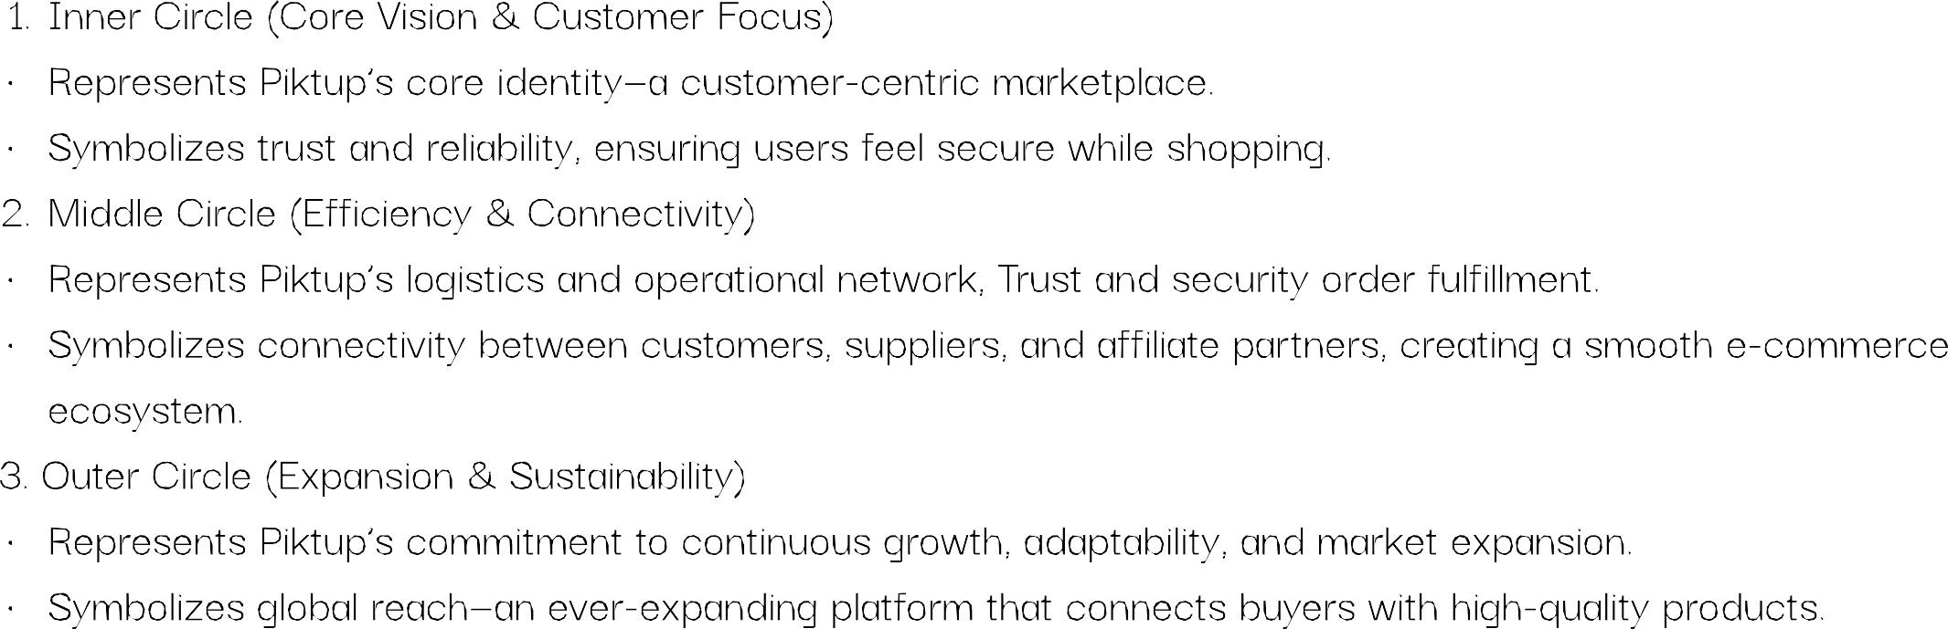

Slide 12
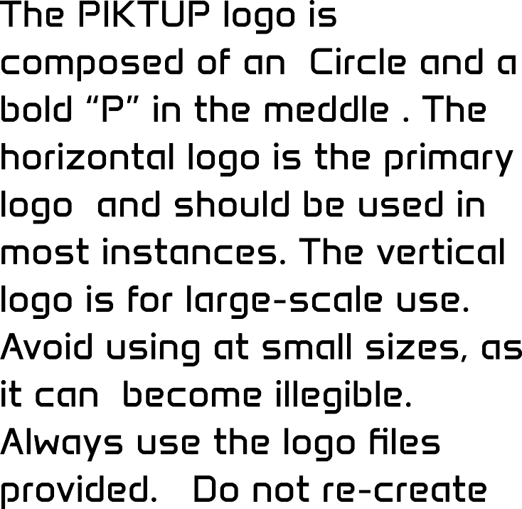



Slide 13









Slide 14





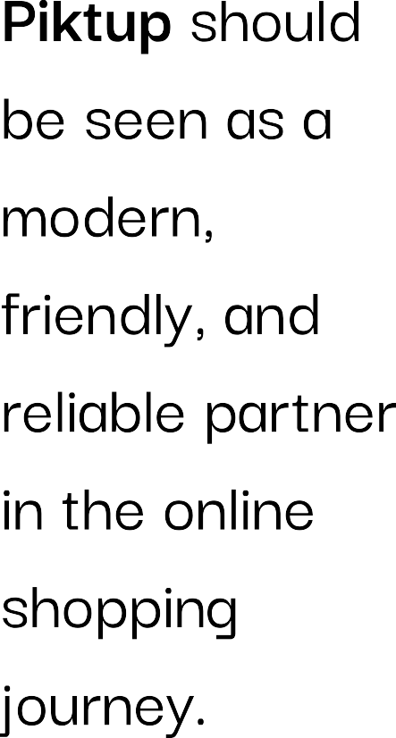
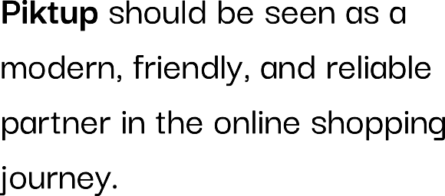

Slide 15





Slide 16




Slide 17












Slide 18


Slide 19

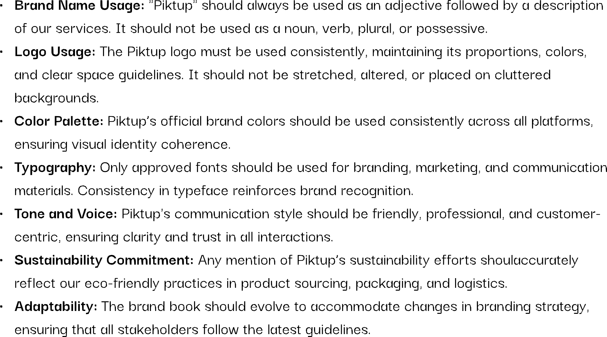

Slide 20
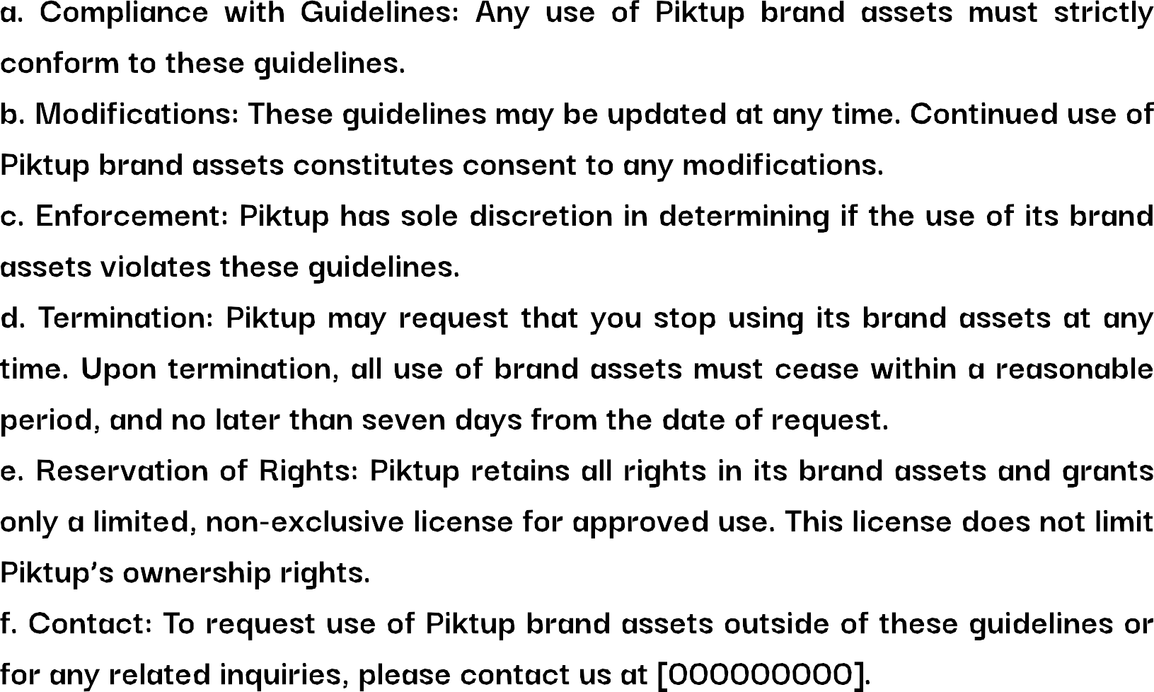

Slide 21



